Slide 1
Bray Team Week 9 Update
Avery Haynes, Locke Lehmann, Travis Carlson, Cody Sims, Zachary Walker, Michael Hager
3/25/2024

Slide 2
Weekly Deliverables
Tasks | Lead | Percentage Done | Notes
Begin potentiometer validation testing | Avery/Michael | 50% | Ready for testing.
Test motor system | Cody/Travis | 50% | Motor mounted into the stem of the actuator and wired to DAQ
Implement strain gauges into stop bolts | Zack | 50% | Made bolt holder, epoxying tomorrow.
Prep Hall effect sensor Test | Locke/Travis | 25% | Made design, received sensor, must print test rig using new circuit board.
Build frame for valve and actuator and motor mount | Cody/Travis | 100% | Completed.

Slide 3
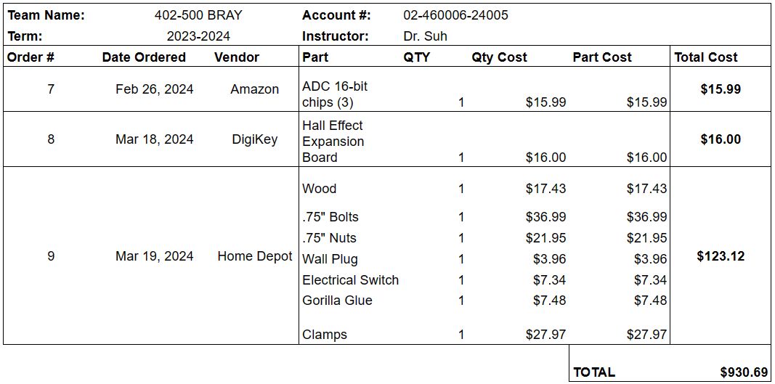
Purchasing Updates
Purchased materials for building testing rigs from Home Depot
Budget Update: $930.69 spent (out of $3,803 approved)
Notes:
Done - Avery 2/18

Slide 4
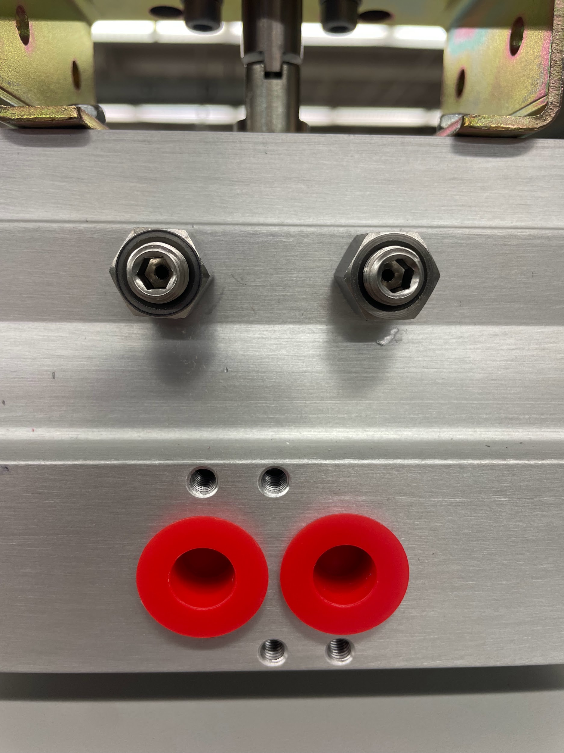
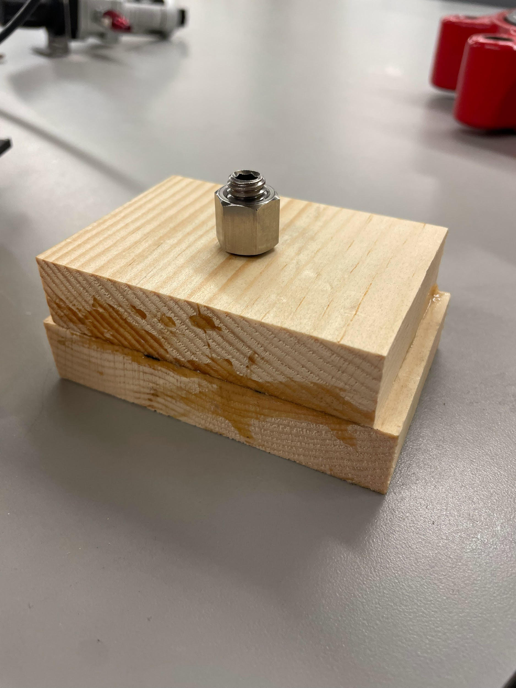
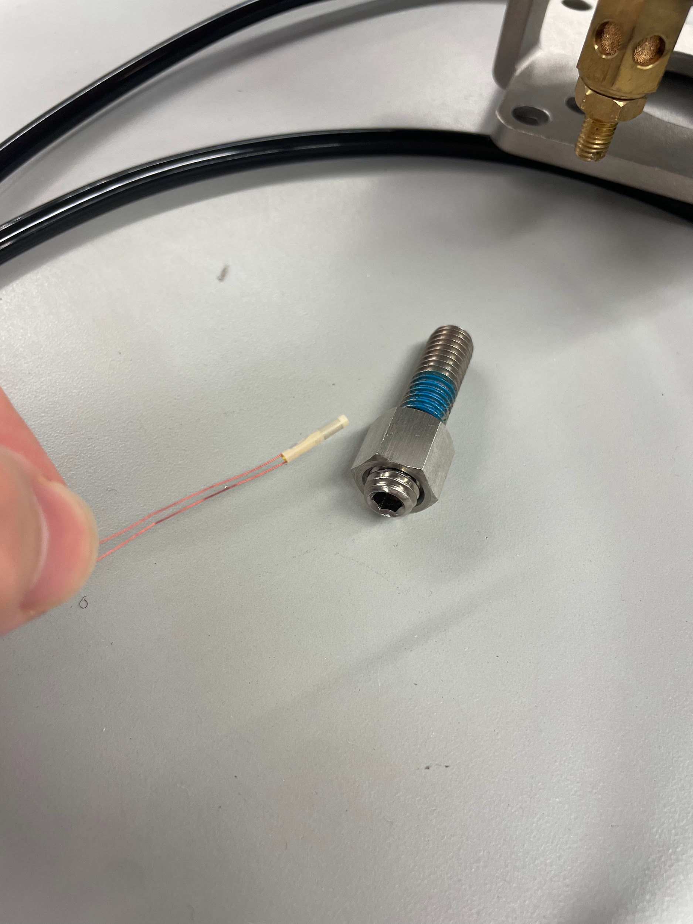
Strain Gauges
Need to figure out how to connect with Raspberry Pi
Epoxying reservation made for Tuesday at common labs

Slide 5
PPE and epoxy supplies
Have Gloves and goggles to epoxy with
Have 1&2 mL serological pipettes
Have a fast release pipette pump
Will complete the epoxy in the fume hood using the bolt holder made
After epoxy is applied will cure in oven at 140 𝇈F for 3 hours

Slide 6
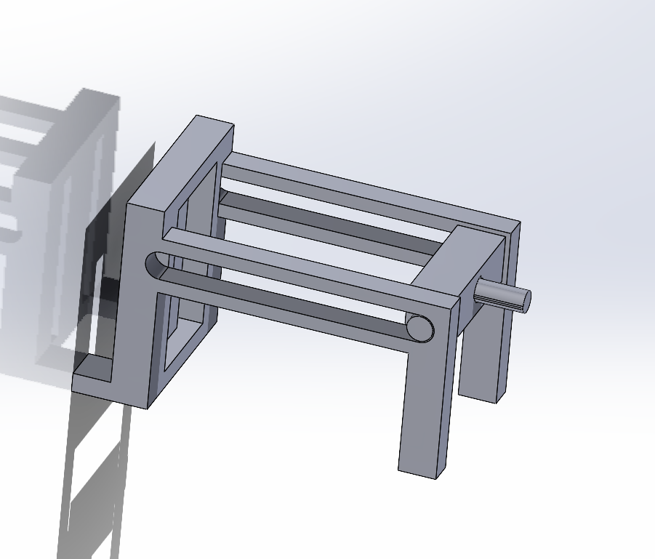
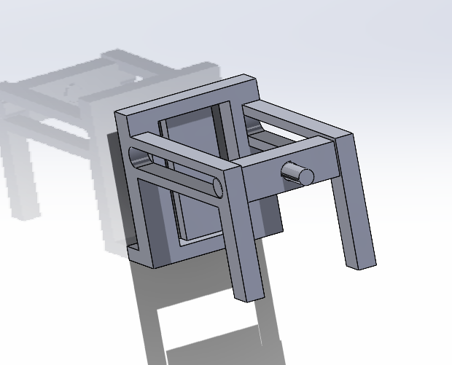
Hall effect sensor testing apparatus
Modeled new frame with actual measurements
Added the shaft to only rotate 90 degrees to collect accurate measurements
Will submit print request today and hopefully test this week if printed fast enough

Slide 7
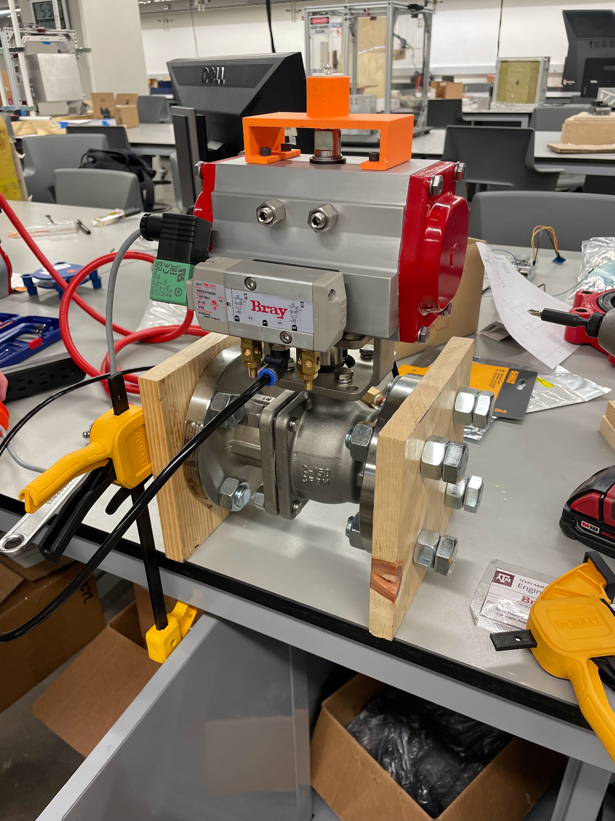
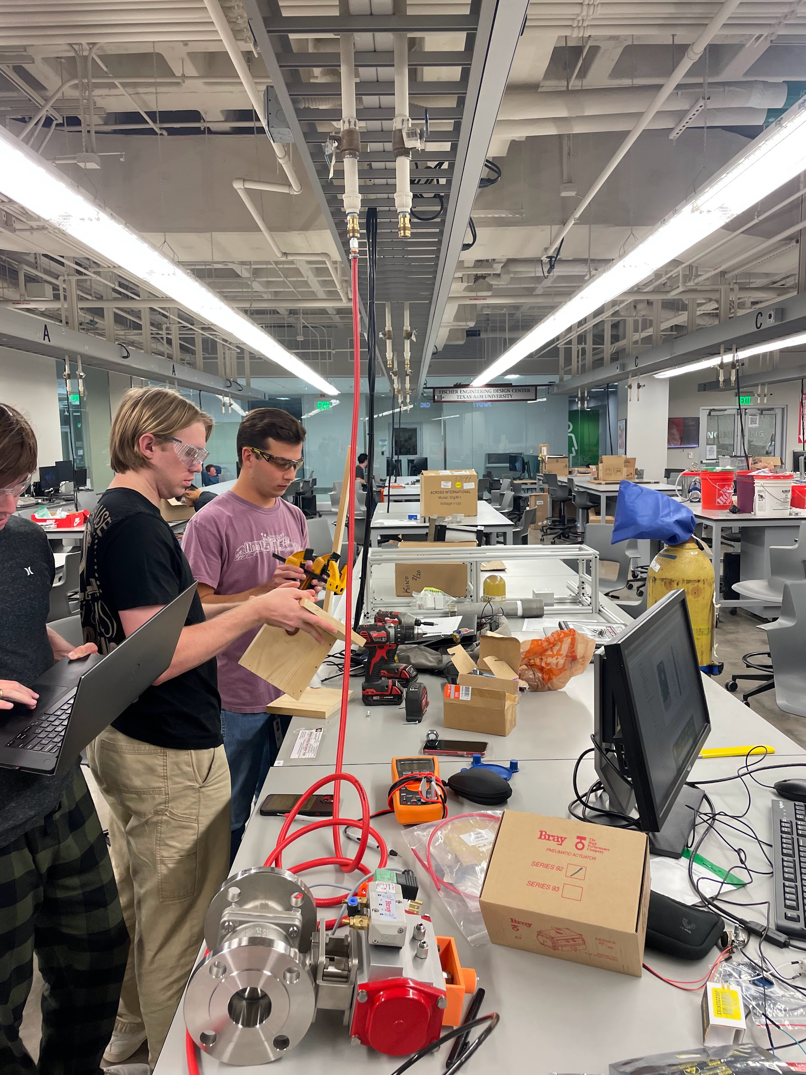
Valve/Actuator Frame
Frame set up and air connected
Actuators can be switched out for testing position/torque

Slide 8
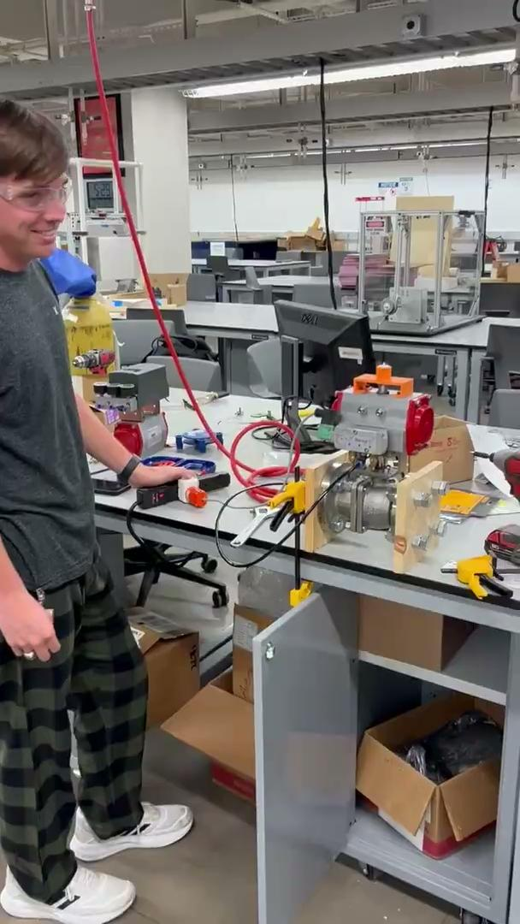
Firing the Actuator
Actuator fired in one direction, does not reverse direction (Will consult with Bray - likely because of no springs)
This week we can test and get data from electric motor and potentiometer, and possibly strain gauges if all goes well with epoxying

Slide 9
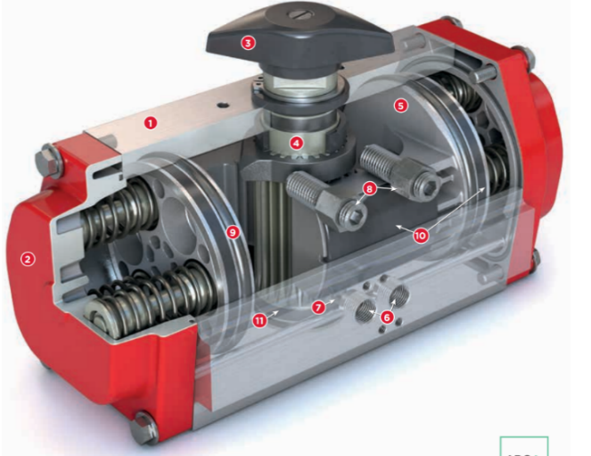
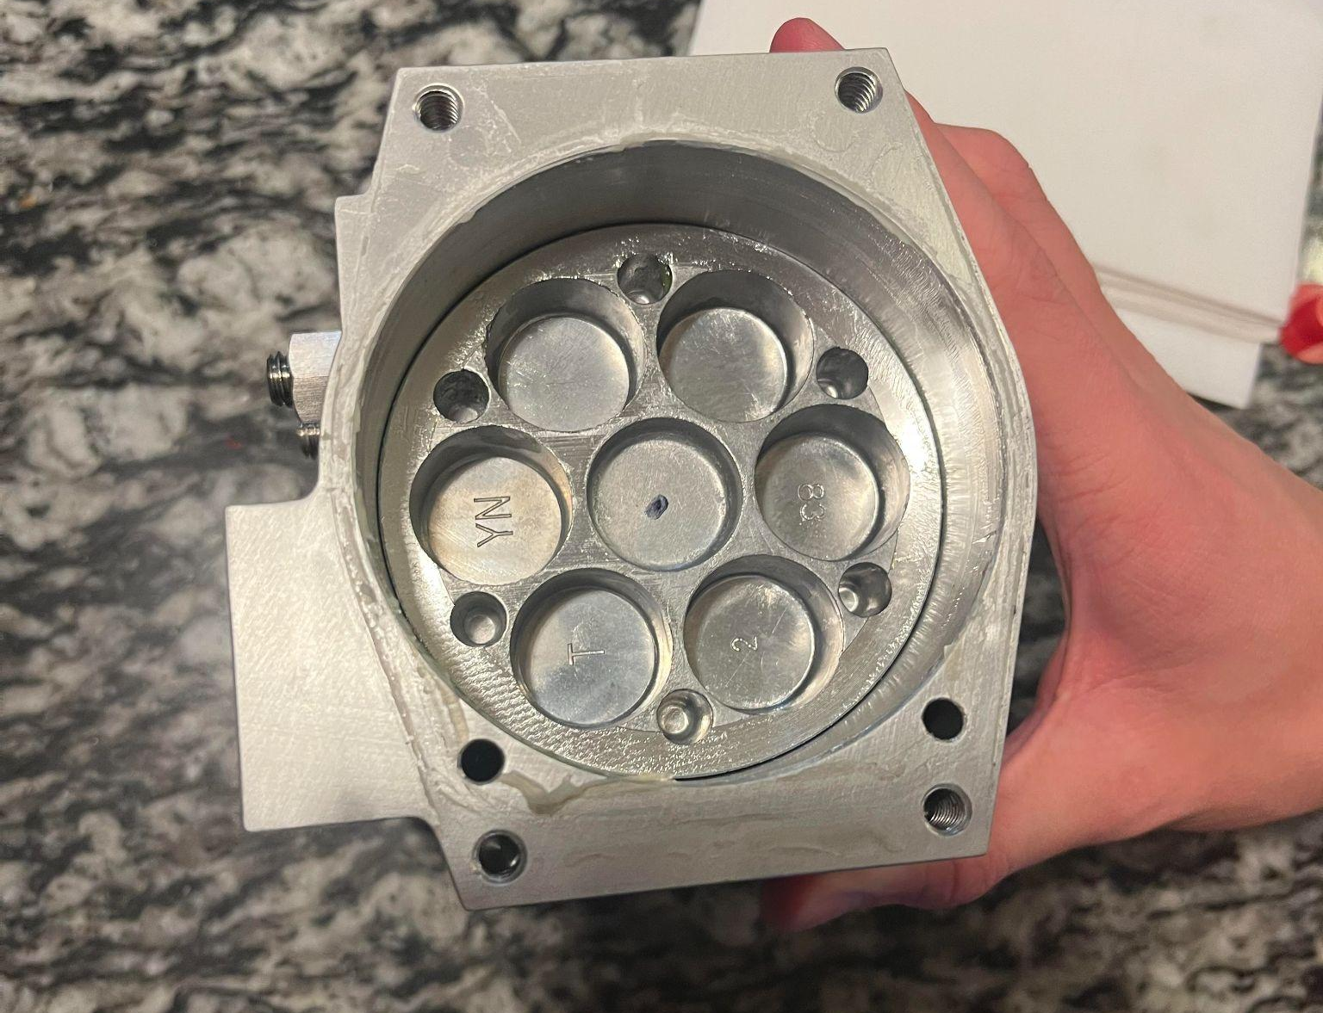
Actuator

Slide 10
Remaining Validation
Print 2nd iteration of hall effect test rig.
Begin testing with potentiometer and electric motor.
Start measuring time and voltage to see if a correct estimate of torque can be made.
Complete epoxying and test strain gauges

Slide 11
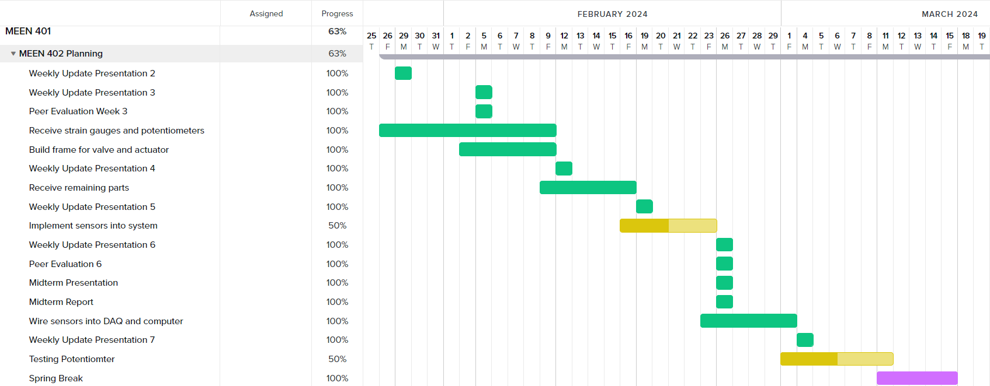
Gantt Chart

Slide 12
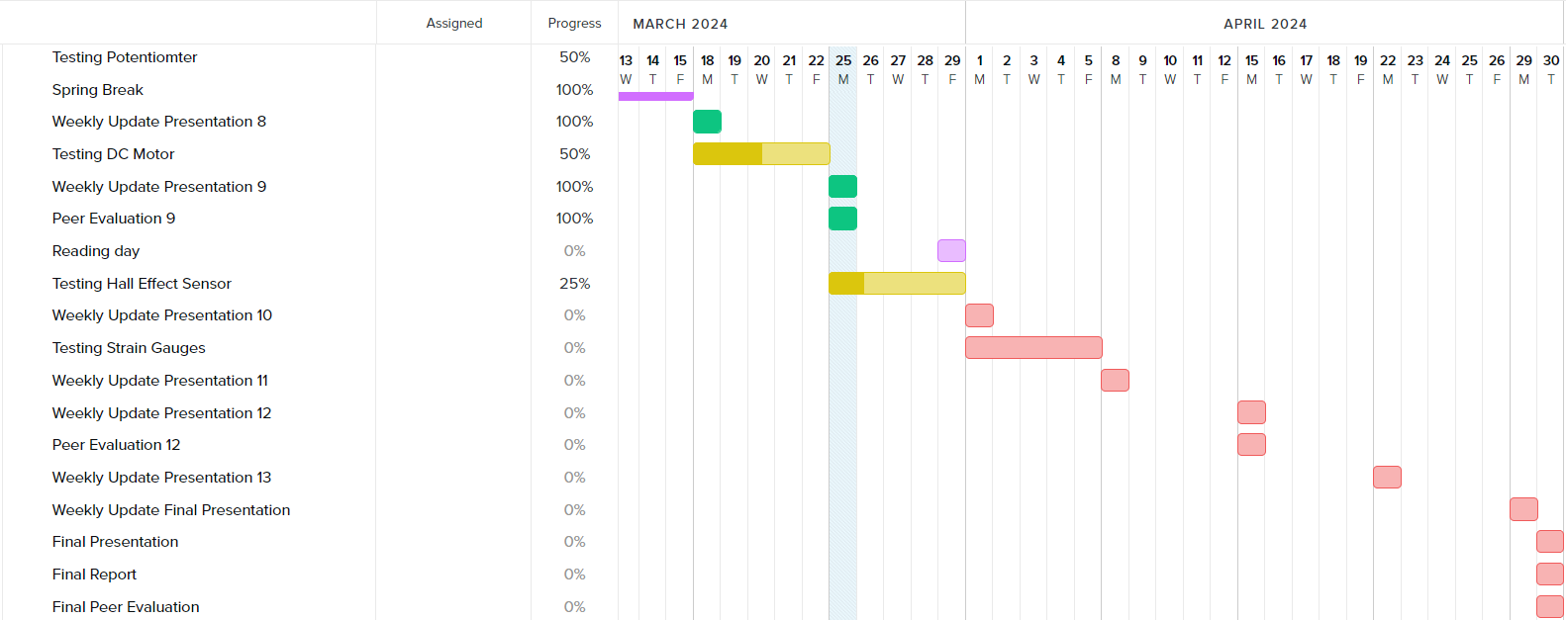
Gantt Chart

Slide 13
Next Week’s Deliverables
Tasks | Lead | Percentage Done | Notes
Begin potentiometer validation testing | Avery/Michael | 50% | Ready for testing.
Strain Gauge Measurement | Avery/ Michael | 0% | Researching if any addtl. Parts needed
Test motor system | Cody/Travis | 50% | Motor mounted into the stem of the actuator and wired to DAQ
Implement strain gauges into stop bolts | Zack | 50% | Doing so tomorrow.
Prep Hall effect sensor Test | Locke/Travis | 25% | Made design, received sensor, must print test rig using new circuit board.

